Slide 1
11- List Comprehensions

Slide 2
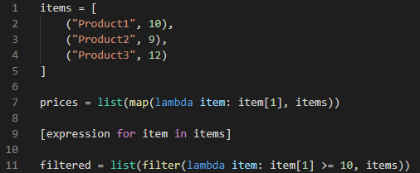
We add our square brackets for defining a list
the preferred way to
Map lists and
filter lists

Slide 3
